Slide 1
ANALYSIS ON ELECTRIC VEHICLE
My latest analysis on Electric Vehicle.
The project was on the Electric Vehicle, sources of energy, which comes in two different ways:
Battery Electric Vehicle (BEV) and
Plug-in Hybrid Electric Vehicle (PHEV) through different providers.
The datasets provided three major area of categories in respect to eligibility of the car battery.
- Clean Alternative Fuel Vehicle Eligible.
- Eligibility unknown as battery range has not been researched.
- Not eligible due to low battery range.
I queried the datasets with MySQL for result comparison and deep insights in the data.
more insights on the report.

Slide 2
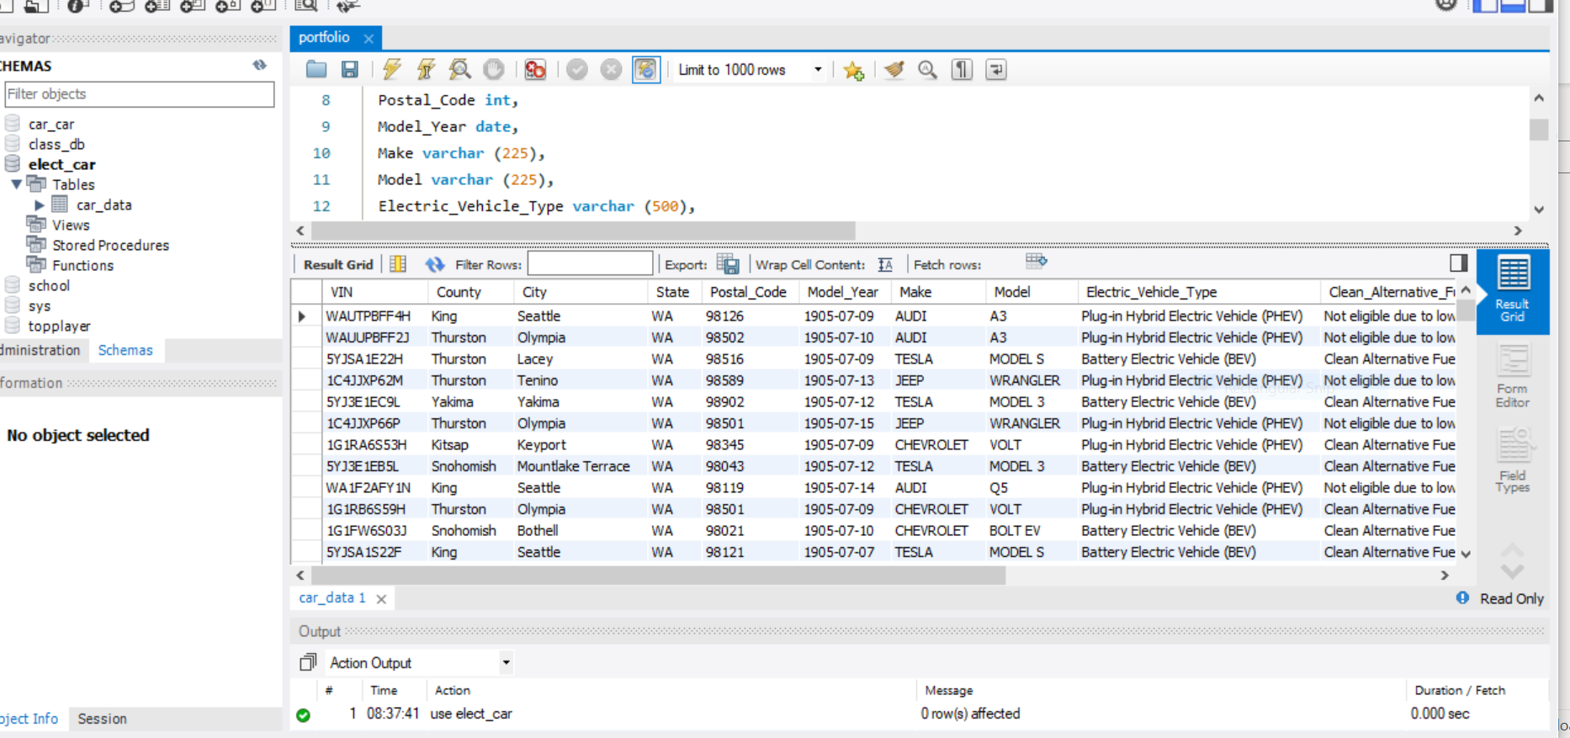

Slide 3
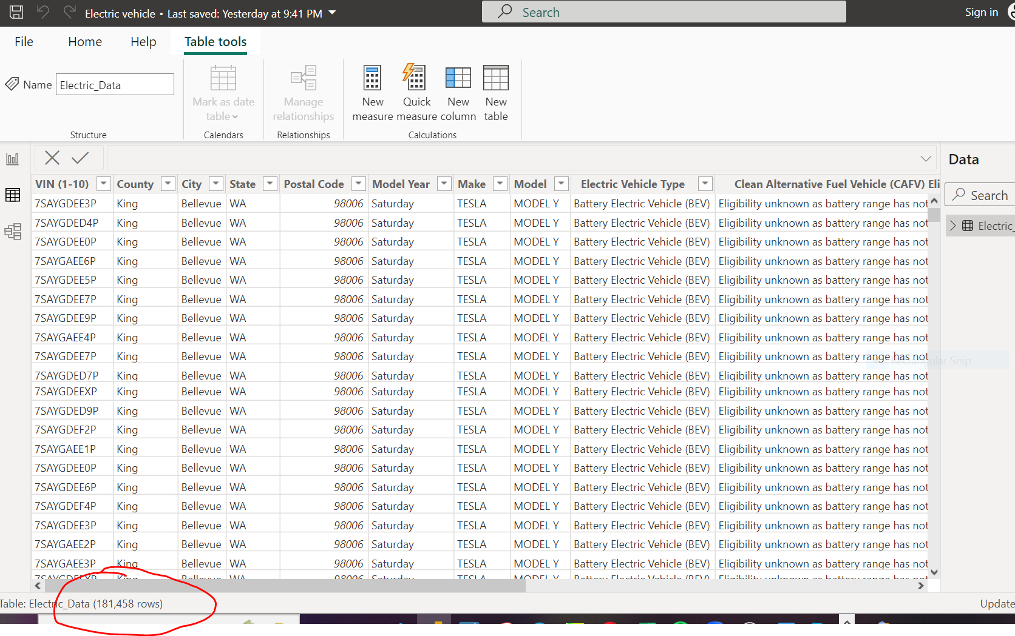

Slide 4
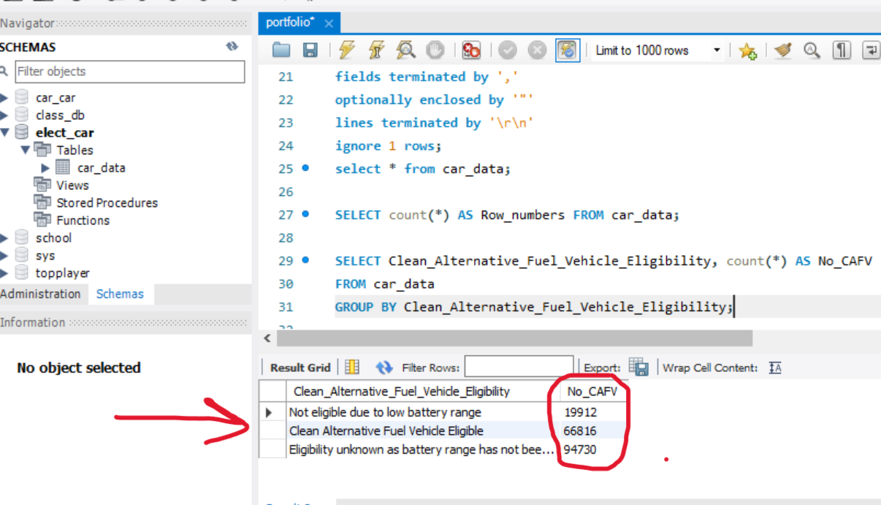

Slide 5
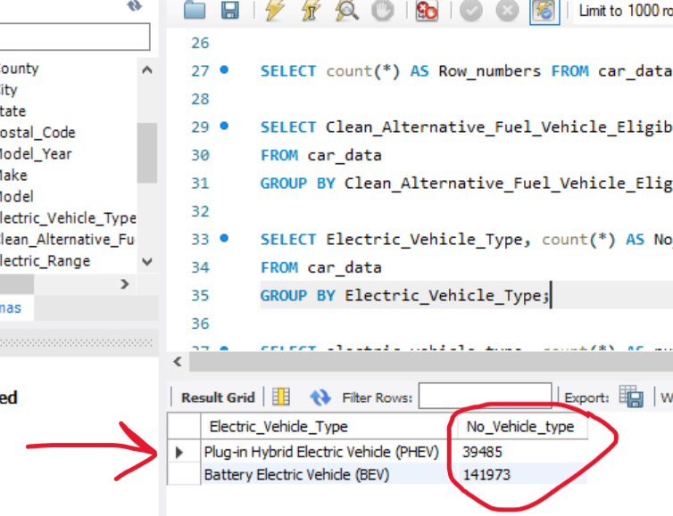

Slide 6
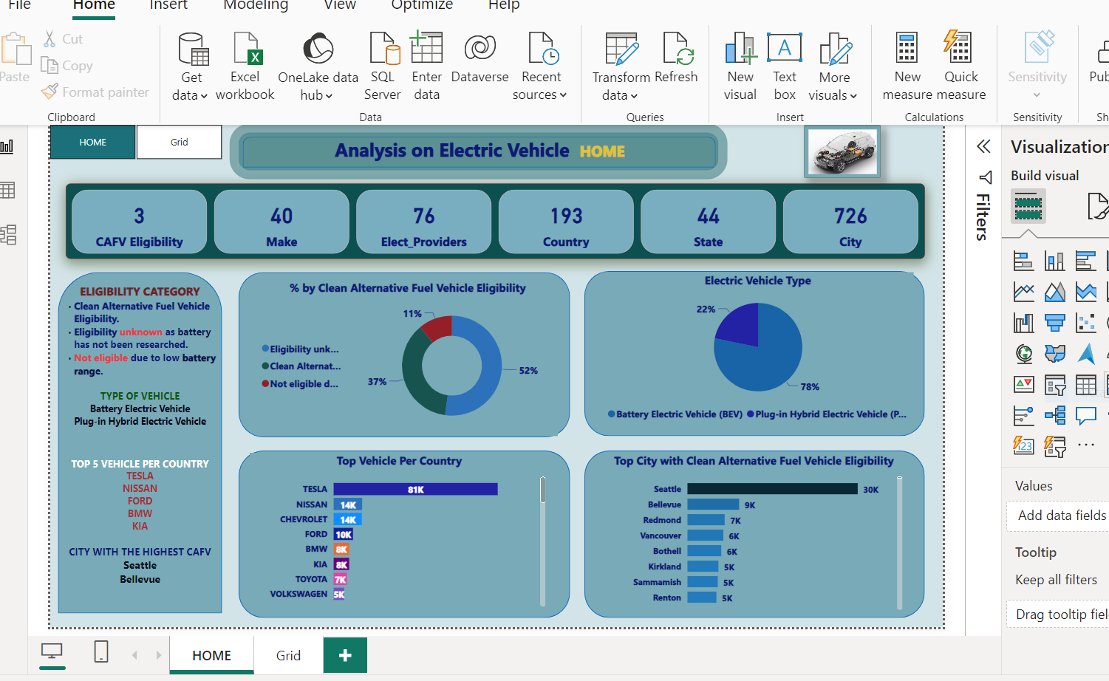

Slide 7
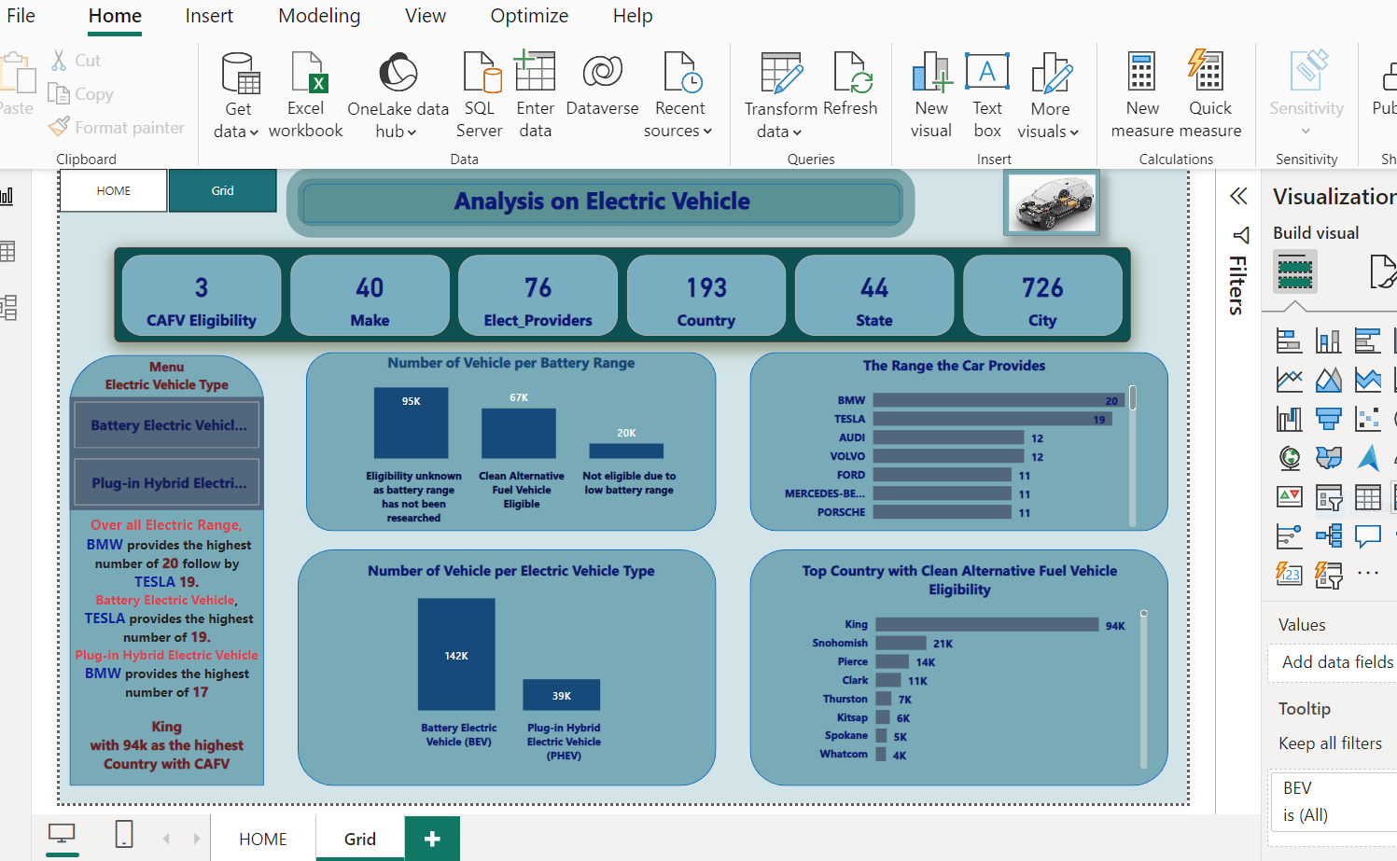

Slide 8
